Slide 1


Individual presentation – Machine Learning CA1 Leopoldo Rojo Romero (Student ID: 2023355)
©CCT College Dublin 2022

Slide 2

Conceptual understanding
Project’s topic: Coronavirus 19 (Covid-19).
Our assignment target is to predict weather a patient with Covid-19 survived or not, taking into consideration multiple comorbidities from each patient.
We will predict the above through Machine Learning models, with an effort of being as accurate as possible with the data that we have.
By performing hyperparameters optimization, we aim to get more consistent and reliable results.

Slide 3
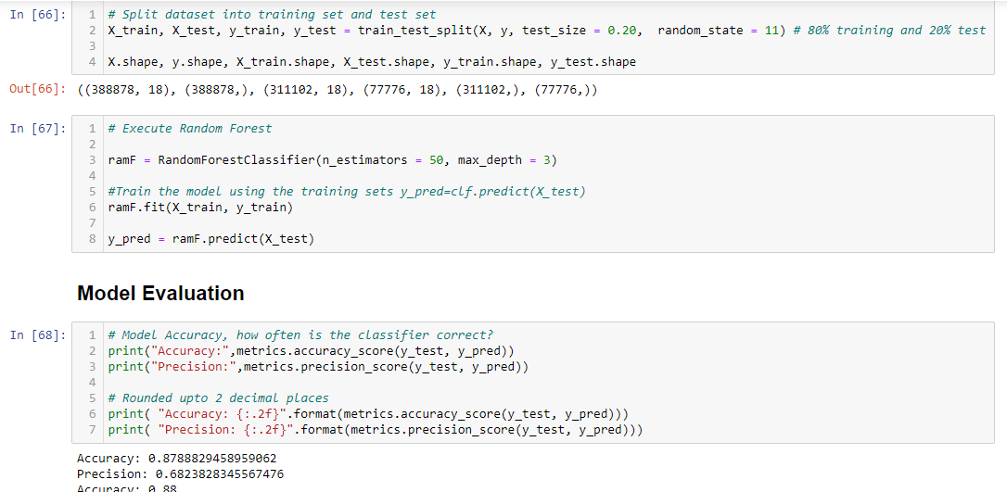
Code development
Random Forest model

Slide 4
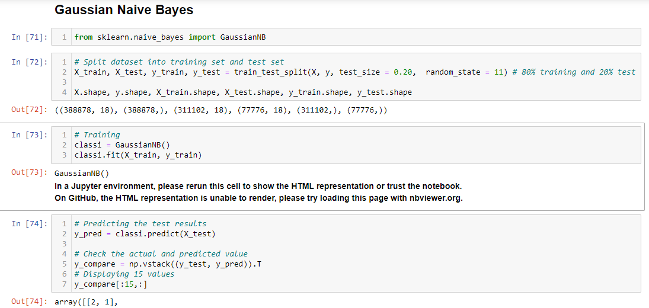
Code development
Gaussian Naive Bayes model:

Slide 5
Code development
After testing our Random Forest and Gaussian Naive Bayes models on multiple train-test sizes, we observed how our models were performing better.
Our Random Forest model had the better results when using the hyperparameters n_estimatiors (number of decisions trees) equal to 50 and a max_depth of each decision tree been 3.
The mentioned above, gave us consistent results over our Gaussian Naive Bayes model, according to multiple types of metrics to evaluate our machine learning models.

Slide 6
Results
Random Forest model was performing better for this project, is consistently predicting if a person died or survived Covid-19 with an Accuracy of 86% - 88% with a proportion of actual positives correctly identified (Recall) of 81% (survived) and 95% (died).
The results were obtained using:
1. Metrics from Sklearn to evaluate the Accuracy and Precision.
2. Classification report from Sklearn.metrics to evaluate Precision, Recall, F1-score and Accuracy.
3. Cross validation score from Sklearn.model_selection to evaluate the Accuracy dividing the data into multiple subsets to obtain a reliable metric and compare it with our previous ones.

